Slide 1
CS246: Search-Engine Scale
Junghoo “John” Cho UCLA

Slide 2
Search Engine: High-Level Architecture
Crawler
Page download & Refresh
Indexer
Page analysis
Index construction
Query Processor
Page ranking
Query logging

Slide 3
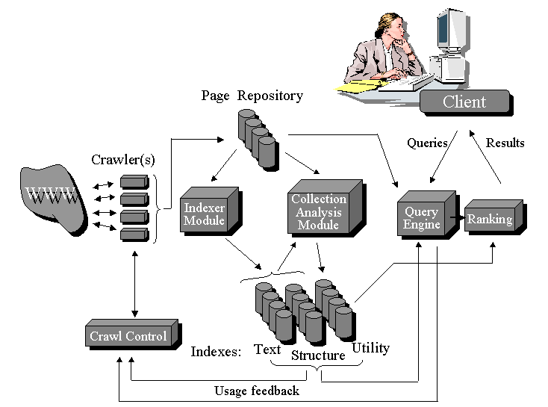
General Architecture

Slide 4
Scale of Web Search
Number of pages indexed: ~ 10 billion pages
23 million pages in 1998
Index refresh interval: once per month (~ 1200 pages/sec)
Number of queries per sec: ~ 40,000 queries/sec
Services often run on commodity Intel-Linux boxes

Slide 5
Other Relevant Statistics
Average page size: 2MB
Average query size: 40B
Average result size: 5KB

Slide 6
Size of Dataset
Total raw HTML data size:
10 billion x 2MB = 20 PB! (150GB in 1998)
Inverted index roughly the same size as raw corpus
20 PB for index itself
With simple compression, easy to get 3:1 compression ratio
~7 PB compressed (let’s use 8 PB for simplicity)
Number of disks necessary for one copy
8 PB / 10TB per disk = 800 disk

Slide 7
Impact of Data Size on Web Crawling
Efficient crawl is very important
1 page/sec → 1200 machines just for crawling!
Parallelization through multi-threading/event-queue necessary
Complex crawling algorithm -- No, No!
With reasonable optimization
~ 100 pages/sec/machine (10 ms/page)
~ 12 machines for crawling
Bandwidth consumption
1200 x 2MB x 8bit ~ 20 Gbps

Slide 8
Impact of Data Size on Indexing
Efficient Indexing is critical
1200 pages/sec
Indexing steps
Load page – Network intensive
Extract and sort word, create postings – CPU intensive
Write postings – Disk intensive
Pipeline indexing steps
P1
L
S
W
P2
L
S
W
P3
L
S
W

Slide 9
Simplified Indexing Model
S
D
Model
Copy 8PB data from disks in S to disks in D through network
S: crawling machines
D: indexing machines
8PB crawled data, 8PB index
Ignore actual processing
4x 10TB disks per machine
~200 machines in S and D each
16GB RAM per machine
:
:

Slide 10
Data Flow
Disk → RAM → Network → RAM → Disk
No hardware is error free
Disk (undetected) error rate ~ 1 per 10¹³
Network error rate ~ 1 bit per 10¹²
Memory soft error rate ~ 1 bit error per month (1GB)
Typically go unnoticed for small data
Network
Disk
RAM
RAM
Disk

Slide 11
Data Flow
Assuming 1Gps link between machines
40TB per machine, 100MB/s transfer rate → 40,000 seconds (~half day) just for data transfer
Network
Disk
RAM
RAM
Disk

Slide 12
Errors from Disk
Undetected disk error rate ~ 1 per 10¹³
8 PB * 8 bits (= 64 x 10¹⁵ bits) data read in total 8 PB * 8 bits (= 64 x 10¹⁵ bits) data write in total → 2 x 6,400 (= 12,800) bit errors (just because we are reading/writing from disk!!)
Network
Disk
RAM
RAM
Disk

Slide 13
Errors from Memory
1 bit error per month per 1 GB
400 machines with 16 GB each → 6,400 GB memory → 6,400 bit errors/month (= 100 bit errors/half day) (just because so we use so many systems!!)
Network
Disk
RAM
RAM
Disk

Slide 14
Errors from Network
1 error per 10¹²
8 PB x 8 bits (= 64 x 10¹⁵) transfer → 64,000 bit errors from network transfer!!
Network
Disk
RAM
RAM
Disk

Slide 15
Impact of Data Size on Data Corruption (1)
During indexing, something always goes wrong
64,000 bit errors from network
6,400 bit errors from disk IO
100 bit errors from memory
Very difficult to trace and debug
Pure hardware errors, but very difficult to differentiate hardware error and software bug
Software bugs may also cause similar errors
Our “consumer” OS/application is not designed to deal with such errors yet

Slide 16
Impact of Data Size on Data Corruption (2)
Our data pipeline should verify data integrity in every step
Data corruption in the middle of, say, sorting completely screws up the sorting
Need a data-verification step after every operation
Algorithm, data structure must be resilient to data corruption
Check points, etc.
ECC RAM is a must
Can detect most 1 bit errors

Slide 17
Scale of Query Processing
40,000 queries / sec
Rule of thumb: 10 requests / sec / CPU
The exact number depends on number of disks, memory size, etc.
~ 4,000 machines just to answer queries
5KB / answer page
40,000 x 5KB x 8bit ~ 1.6 Gbps

Slide 18
Scale of Query Processing
Index size: 8 PB → 800 disks, 200 machines
Potentially 200-machine cluster to answer a query
If one machine goes down, the cluster may go down
Multi-tier index structure can be helpful
Tier 1: Popular (high PageRank) page index
Tier 2: Less popular page index
Answer most queries with tier-1 cluster

Slide 19
Impact of Data Size on System Reliability
Disk mean time to failure: ~ 3 years → (3 x 365 days) / 800 disks ~ 1 day
One disk failure every day!!
Remember, this is just for one copy
Data organization should be very resilient to disk failure
We should never lose data even if we lose a disk

Slide 20
Hardware at Google
~10K Intel-Linux cluster
Assuming 99.9% uptime (8 hour downtime per year)
10 machines are always down
Nightmare for system administrators
Assuming 3-year hardware replacement
Set up, replace and dump 10 machines every day
Heterogeneity is unavoidable
Job posting at Google
Position Requirements:
Able to lift/move 20-30 lbs equipment on a daily basis.

